Slide 1
Welcome to Forsyth!
New Faculty Orientation – February 26, 2018

Slide 2
Teaching & Research: Instructional Presentations & Events

Slide 3
Teaching & Research: Instructional Presentations & Events

Slide 4
Teaching & Research: Information Literacy
Familiarize students with different types of resources
Learn about research topic selection
Know difference between credible sources & simple googling
Know how to incorporate & cite resources
Overcome “library anxiety”
Librarians available by email, phone, text, and online chat.
Ask-a-librarian service: http://libanswers.fhsu.edu/

Slide 5
Information Literacy – General Education (draft)
The student will …
1. design a research plan that:
incorporates a clear research question;
identifies appropriate information resources;
produce a research log that clearly demonstrates the application of appropriate keyword search criteria, such as Boolean operators, source types, and limiters;
write an annotated bibliography that:
critically analyzes the context, relevance, and authority of an information source, particularly in light of new perspectives, additional voices, and changes in school of thought;
applies appropriate disciplinary conventions of citation.

Slide 6
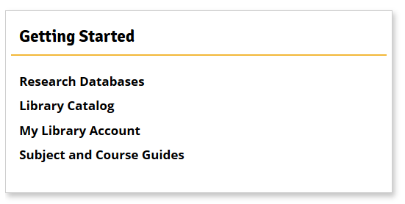
Teaching & Research: Course / Subject Guides
Each program has a liaison from the library: http://www.fhsu.edu/library/ForsythStaff/
Liaisons visit departments and classes & will work with you and your students on incorporating information & literacy into your classes.
http://fhsuguides.fhsu.edu/index.php

Slide 7
Research & Teaching: Proctoring

Slide 8
Research & Teaching: More ….
154 Electronic Resources & Databases Online
Video Production Lab (Media Lab)
MakerSpace & 3D Printing
Writing Center
South Study Area for Presentations (Times Talk)
Computer Lab for Library Instruction
40+ Workstations, Printers, Copiers, Fax
Learning Commons – Equipment Check Out
University Archives & Special Collections
Government Information (Documents) Collection
Oh, and yes we have books ☺

Slide 9
Library Collections & Resources
Resource Trends: | FY12 | FY16 | FY17
Digital Use of E-resources | - | 286,412 | 743,007 | ↑
Physical Items, Circulation | 6,350 | 6,731 | 7,129 | ↑
Searches in Key Resources | 1,049,317 | 2,419,050 | 2,471,424 | ↑
ILL, Borrowed Materials | 4,486 | 3,665 | 3,228 | ↓
ILL, Lent Materials | 3,720 | 2,443 | 2,129 | ↓

Slide 10
Searching for Resources
Add a Scope
Meta Search
Advanced Search
http://www.fhsu.edu/library/

Slide 11
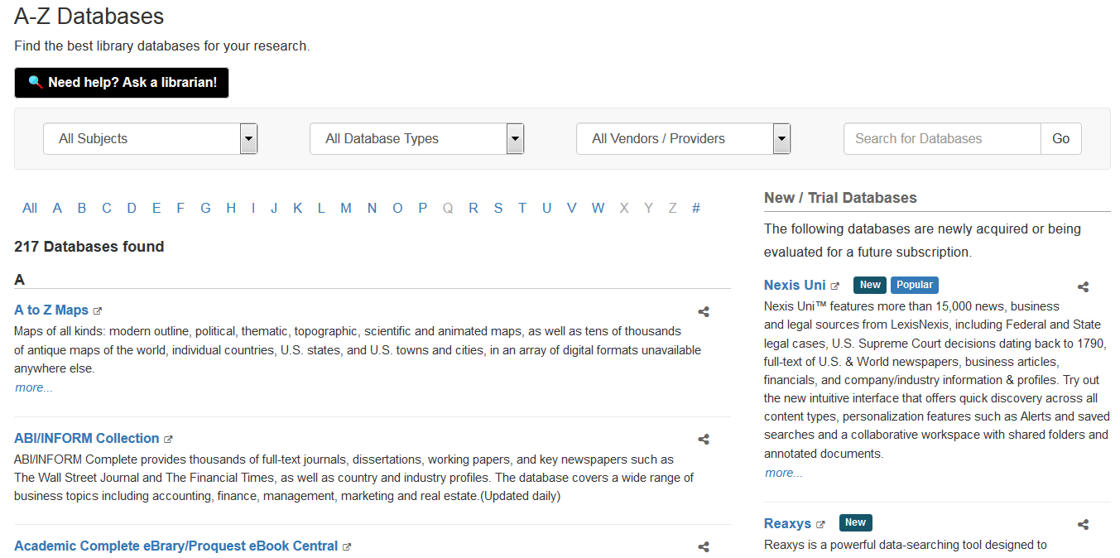
Searching for Resources
Limit Results
New Resources & Trials

Slide 12
FHSU Scholars Repository
https://scholars.fhsu.edu/
Institutional Repository Statistics | FY16 | FY17 | Growth
- Repository Items Available | 1,489.00 | 2,345.00 | 57% ↑
- Item Uses (downloads) | 1,663.00 | 8,555.00 | 414%↑

Slide 13
Scholarly Communication @ FHSU
Advocacy for Open Access Publishing & OER
OA Options & Sources
Publisher & License agreements
Peer Review Journal Start Up
Theses & Dissertations
Open Textbook Adoption or Authoring Grants
Copyright & Fair Use Questions
Course pack materials
Jennifer Sauer – Scholarly Communications & Electronic Resources
Claire Nickerson – Open Education & Learning Initiatives

Slide 14
University Archives & Special Collections
Archives – University History & Records
Tiger Tales Initiative
Records Management & Retention
Special Collections
Western Collection
Military History
Ethnic & Regional Heritage
Rare & Unique artifacts
Digital Collections

Slide 15
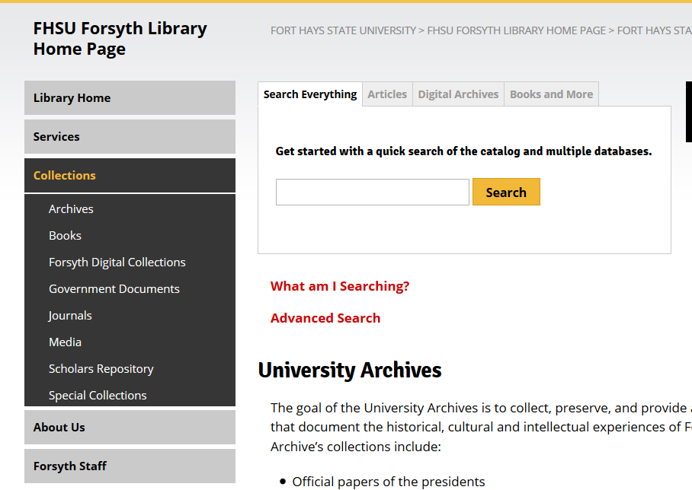
Collections, Archives, & Special Collections

Slide 16
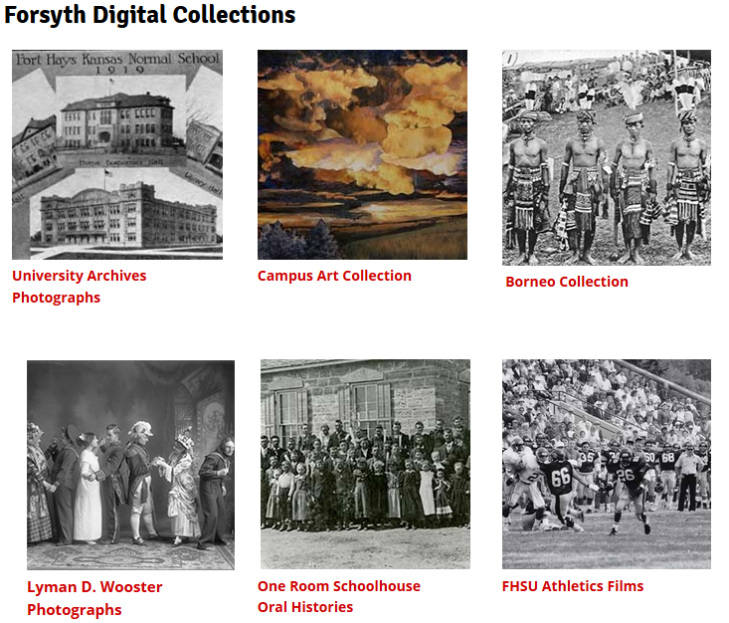
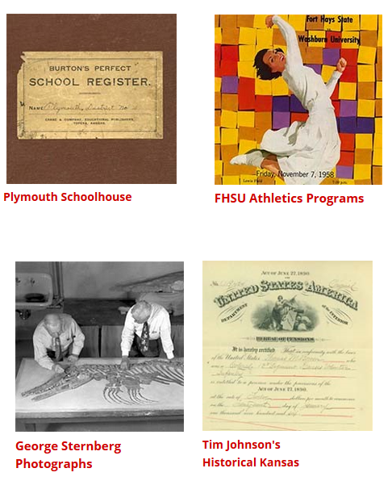
- Examples of Forsyth Digital Collections

Slide 17
Questions?

